Slide 1





HERITAGE HUB
GE19612 - PROFESSIONAL READINESS FOR INNOVATION, EMPLOYABILITY AND ENTREPRENEURSHIP
PRESERVING THE ROOTS OF CULTURE FOR THE BLOSSOMING OF FUTURE GENERATIONS
MOHANA PRASATH G (210701163) JAYA SURIYA R (210701513)
MARIA JOSHIN M (210701153)
PROJECT COORDINATOR:
Dr. K. Anantha Jothi , M.Tech ,Ph.D
Assistant Professor(SG) DEPARTMENT OF COMPUTER SCIENCE AND ENGINEERING

Slide 2
Problem Statement
The rich cultural heritage of Tamil Nadu, encompassing languages, rituals, artifacts, and traditional knowledge, is threatened by modernization and insufficient preservation efforts. Current methods often lack comprehensive documentation, authenticity, and effective community engagement, leading to incomplete representations and a disconnect between generations. There is an urgent need for a digital platform that provides an authentic and comprehensive repository of Tamil Nadu's cultural heritage, facilitating cross-generational dialogue and fostering appreciation and revitalization of its diverse elements. Leveraging advanced technologies like interactive multimedia and virtual exhibitions, this platform can offer immersive experiences, ensuring the accurate preservation and celebration of Tamil Nadu's cultural legacy for future generations.

Slide 3
Abstract
Heritage Hub is a digital platform dedicated to saving and sharing endangered indigenous cultures. It helps different generations connect and keeps diverse traditions alive using modern technology. Heritage Hub collects and preserves indigenous knowledge, artifacts, languages, rituals, and traditions from around the world. By working with indigenous communities, experts, and scholars, it ensures the information is accurate and genuine. The platform features interactive multimedia and virtual exhibits, offering engaging and educational experiences for users of all ages. Heritage Hub is a vital resource for exploring, learning about, and celebrating indigenous heritage, ensuring it is cherished for future generations.

Slide 4
Existing System
The current system for preserving and sharing endangered indigenous heritage is fragmented, relying on physical archives, local museums, and oral traditions that are often not systematically documented or easily accessible to a broader audience. There is no centralized platform that cohesively integrates various elements of indigenous cultures into a comprehensive repository, making it difficult to preserve and share the richness and diversity of these traditions effectively.
Moreover, existing systems often fail to incorporate advanced technology, limiting their ability to engage younger generations and a wider audience. They do not leverage interactive multimedia, virtual exhibitions, or collaborative tools, resulting in a significant gap in creating immersive and engaging experiences.
4

Slide 5
Proposed System
Comprehensive Digital Repository: The platform will serve as a centralized repository, meticulously curating indigenous knowledge, artifacts, languages, rituals, and traditions from Tamil Nadu. By systematically documenting and digitizing these cultural elements, the repository will be accessible to a global audience, ensuring the preservation and dissemination of Tamil Nadu's rich cultural heritage.
Technological Integration: Leveraging interactive multimedia, virtual exhibitions, and collaborative tools, the platform will provide immersive and engaging experiences. These features will facilitate a deeper understanding and appreciation of Tamil Nadu's cultural heritage, making it appealing to users of all ages, especially younger generations.
Collaborative Community Involvement: The system will emphasize collaboration with indigenous communities, cultural experts, and scholars to ensure the authenticity and accuracy of preserved cultural elements

Slide 6
Aim and Objectives
Aim:
The Heritage Hub project aims to create a digital platform that preserves Tamil Nadu's indigenous heritage. Through advanced technology and community collaboration, it ensures authenticity and accessibility. By bridging traditional culture with modern tools, the project fosters cross-generational dialogue. Ultimately, it seeks to safeguard and celebrate Tamil Nadu's cultural legacy for future generations.
Objectives:
Preserve and document Tamil Nadu's diverse cultural heritage.
User-friendly digital platform accessible to people of all ages, backgrounds, and abilities
3. Promote awareness and understanding of Tamil Nadu's cultural heritage

Slide 7
Hardware & Software Requirements
Desktop/Laptop Computers:
Processor: Intel Core i3 or equivalent
RAM: 4GB or higher
Storage: 128GB SSD or higher
Display: 15-inch monitor or larger
Operating Systems:
Database Server: MongoDB 4.4 or later
Client Devices: Windows 10, macOS 10.15, iOS 12.0, Android 7.0, or later
Development Tools:
Integrated Development Environment (IDE): Visual Studio Code
Version Control: Git, GitHub
Backend Technologies:
Programming Language:Node JS
Database Connectivity: MongoDB
Frontend Technologies:
HTML5, CSS3, JavaScript,React
Frontend Framework: Bootstrap 4.5.2 or later

Slide 8
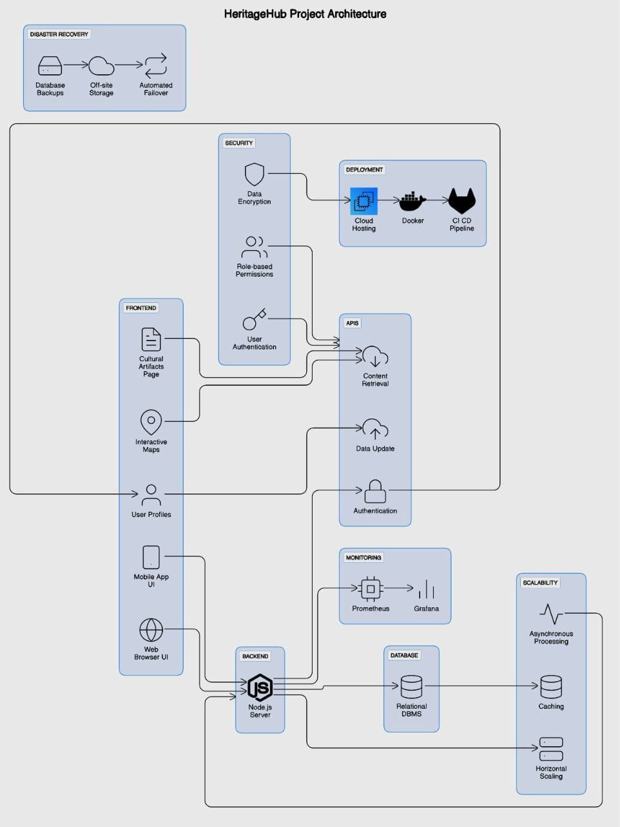
Architecture Diagram

Slide 9
Functional Description
MODULES
1 User Interface (UI) Module:
Responsible for designing an intuitive and culturally sensitive user interface that facilitates easy navigation and access to platform features.
Includes components for user registration, authentication, profile management, and language localization to accommodate diverse user needs.
Incorporates multimedia elements, interactive maps, and storytelling interfaces to engage users with indigenous cultural materials.
2 Content Management Module:
Handles the curation, organization, and storage of indigenous cultural materials, including artifacts, oral histories, traditional knowledge, and contemporary expressions.
Implements protocols for documenting cultural metadata, ensuring authenticity, and respecting intellectual property rights and community protocols.

Slide 10
Sample coding
App.js
const express=require('express')
const cors=require('cors')
const mongoose = require('mongoose')
const port=90;
const app = express()
app.use(cors())
app.use('/uploads', express.static('uploads'));
app.use('/galleryPics', express.static('galleryPics'));
const user=require('./routes/user')
const post=require('./routes/post')
const gallery=require('./routes/gallery')
app.use(express.json())

Slide 11
Sample coding
app.use(gallery)
app.get('/',(req,res)=>{
res.send("Welcome Captain...")
})
// app.get('/login',(req,res)=>{
// res.send("Login to our website...")
// })
mongoose.connect("mongodb://localhost:27017/HeritageHub")
.then(()=>{
console.log("Connected to DB...")
app.listen(port,()=>console.log("listening to port",port))
})

Slide 12
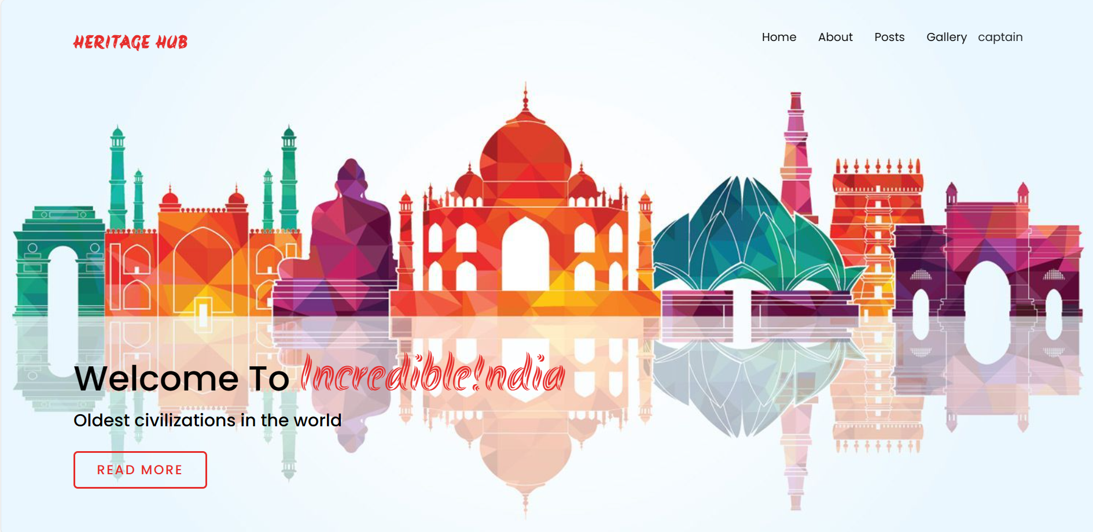
Outputs and Final Results

Slide 13
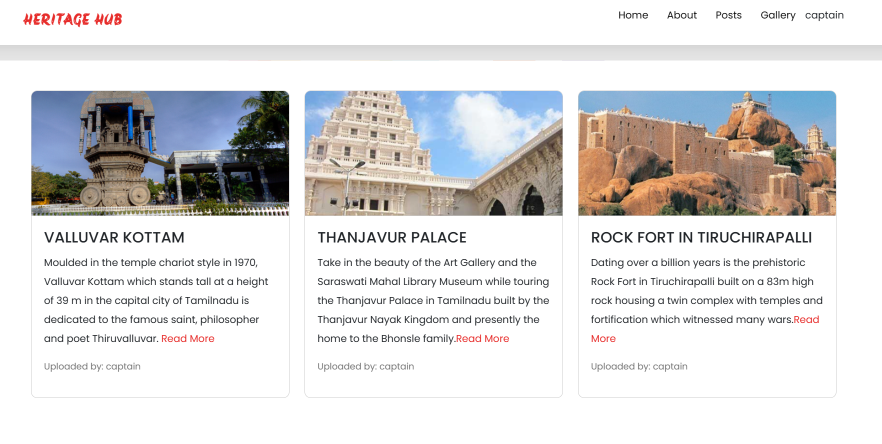
Outputs and Final Results

Slide 14
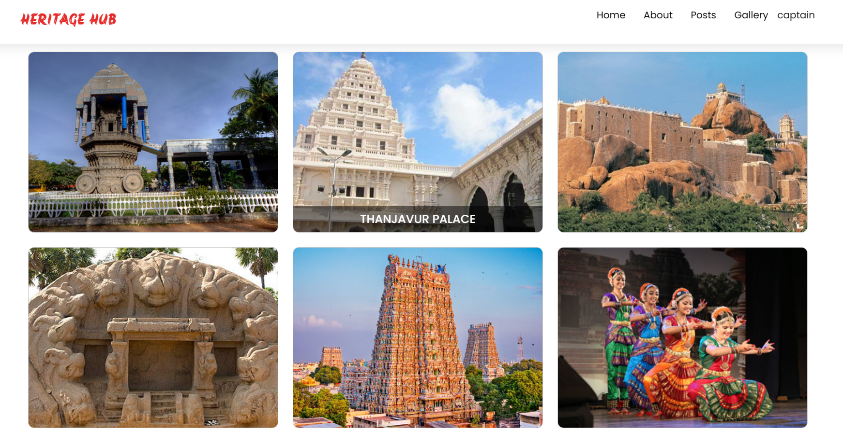
Outputs and Final Results
Gallery

Slide 15
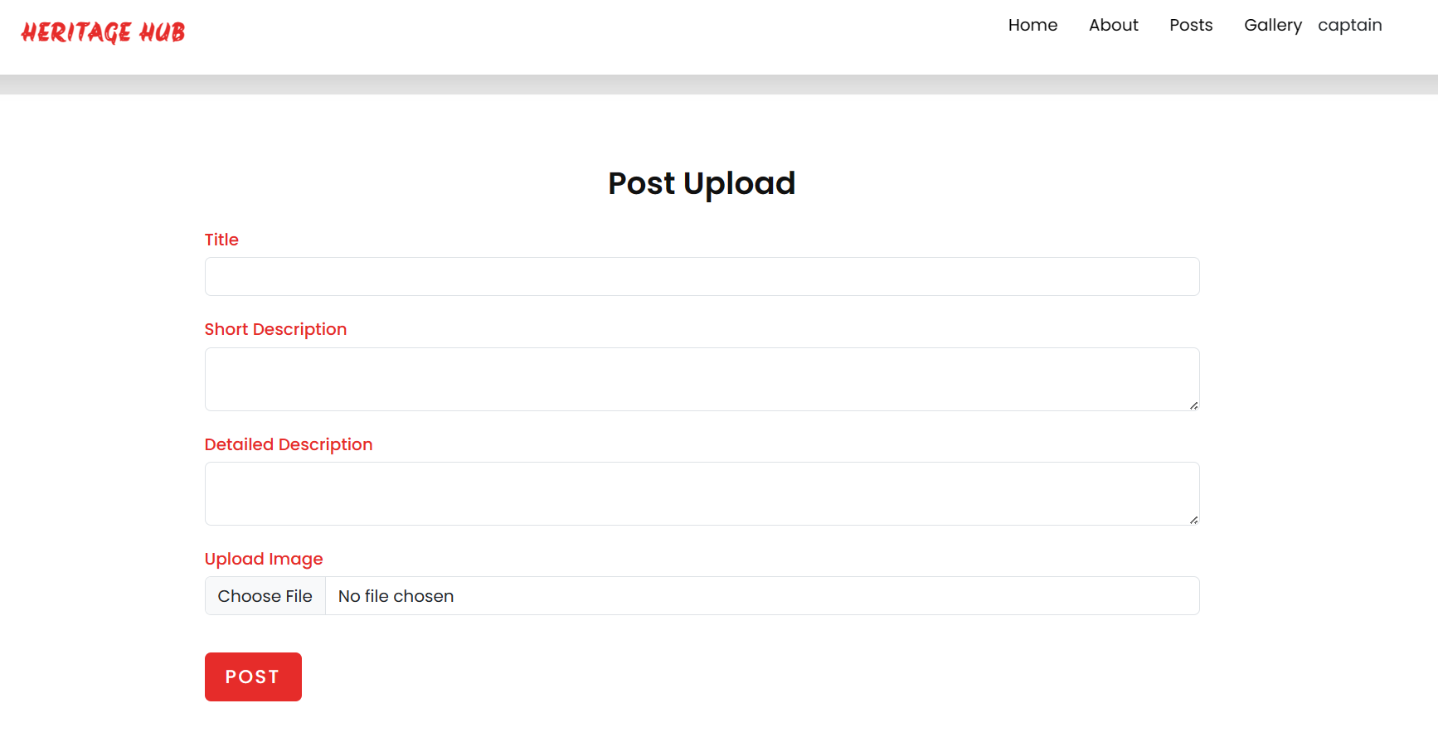
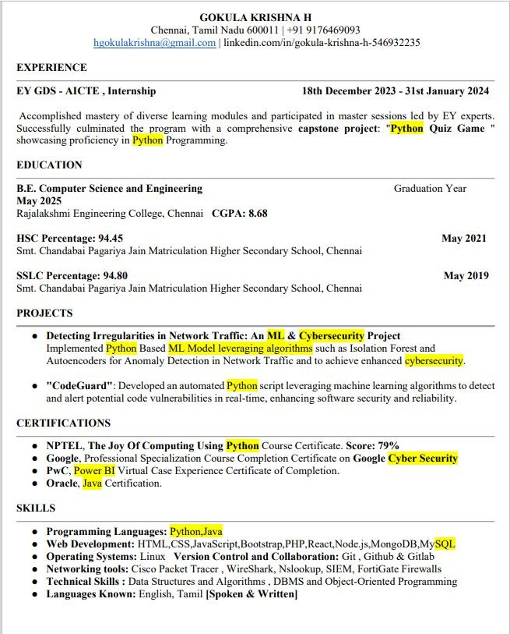


Outputs and Final Results
Sample Resume:

Slide 16
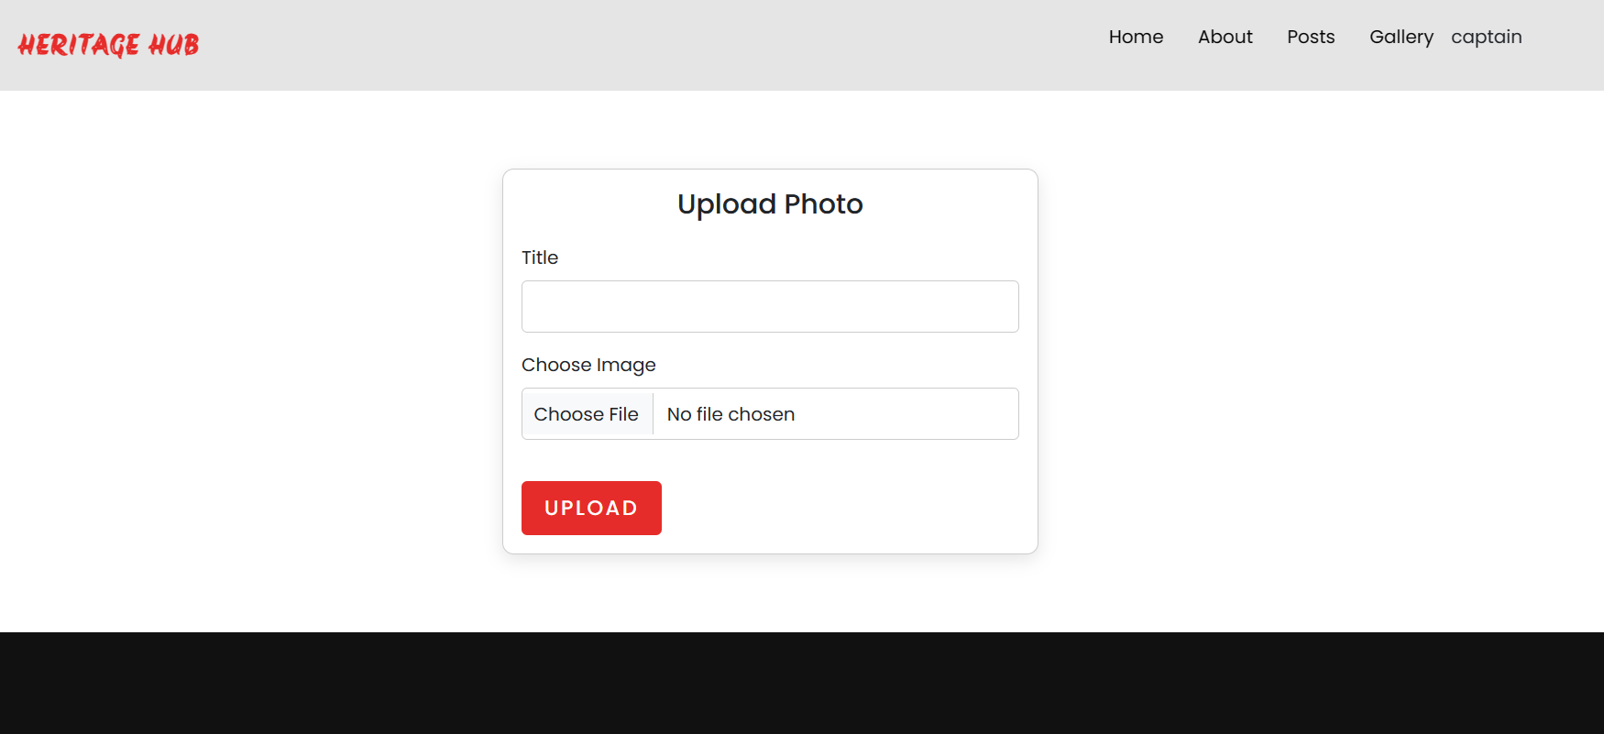
Outputs and Final Results

Slide 17
Conclusion and Future Enhancements
In conclusion, the Heritage Hub project is dedicated to preserving and celebrating endangered indigenous heritage through a comprehensive digital platform. By fostering cross-generational dialogue and leveraging innovative technologies, it bridges traditional wisdom with modern advancements. Grounded in collaboration and inclusivity, the project respects indigenous rights and autonomy while evolving to meet community needs. Ultimately, Heritage Hub aims to leave a lasting legacy that enriches global cultural diversity and fosters mutual respect and understanding.
Future Enhancement
1. Utilize VR technology to digitally preserve and recreate endangered heritage sites or cultural practices that are at risk of being lost, allowing users to experience them in a virtual environment and ensuring their documentation for future generations.
2. Incorporate gamification, quizzes, and multimedia content for engaging educational experiences.

Slide 18
Thank You

